Slide 1

A Parallel Algorithm Template for Updating SSSP in Large-Scale Dynamic Networks
Presented by:
Muhammad Zohaib Raza 22I-1331
Muhammad Awais 22I-1315
Hamid Ali 22I-1047

Slide 2

Introduction to Dynamic Graphs and SSSP
Real-world graphs evolve continuously.
SSSP is essential for logistics and routing.
Recomputing SSSP each update is inefficient.

Slide 3
Importance of SSSP in Dynamic Networks
Social Networks
Transportation
Communication Systems
Support friend recommendations dynamically.
Enable live rerouting based on traffic changes.
Recover routes quickly for resilient networks.

Slide 4
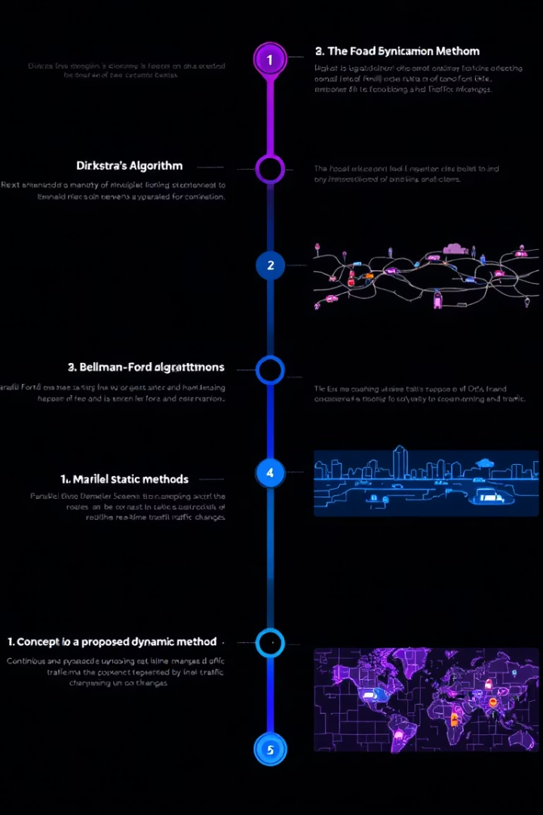
Background & Related Work
1
Static SSSP
Dijkstra and Bellman-Ford algorithms
2
Parallel Static
Gunrock (GPU), Galois (CPU) frameworks
3
Proposed Dynamic
Efficient updates on network changes

Slide 5

Key Challenges in Dynamic SSSP
Fast Local Updates
Lock-Free Scalability
Handle frequent network changes efficiently
Avoid synchronization bottlenecks in parallel
Balanced Workload
Massive Network Support
Distribute computation evenly across threads
Scale to very large dynamic graphs

Slide 6

Our Key Contributions
Platform-independent framework combining CPU & GPU
Utilizes rooted SSSP tree for targeted updates
Achieves 5–8× speedups against full recomputation
Functional blocks minimize redundant work efficiently

Slide 7
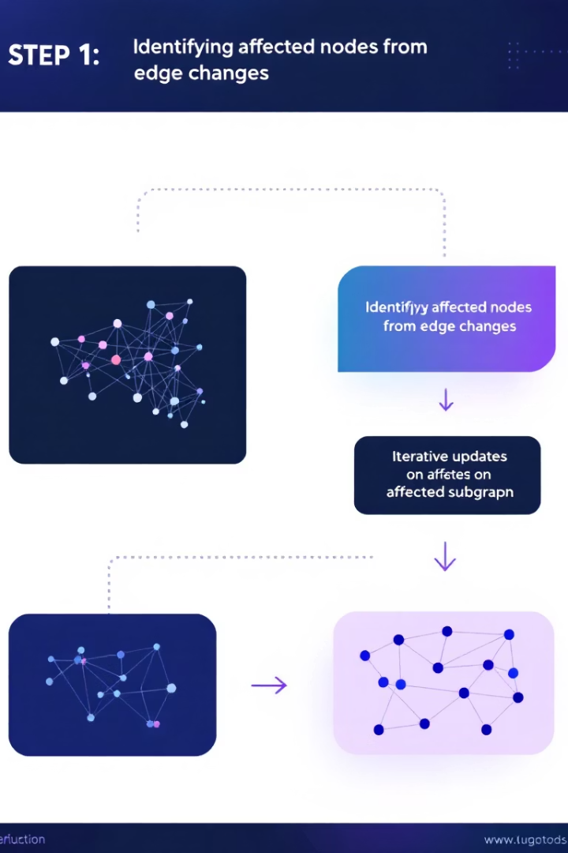


High-Level Algorithm Approach
Step 1: Identify Affected Region
Detect nodes impacted by edge insertions and deletions
Step 2: Update Distances
Iteratively update distances without locks for scalability

Slide 8
Step 1 – Identifying Affected Vertices
Edge Deletion
Edge Insertion
Parallel Processing
Subtree may disconnect and alter paths
New connections may shorten existing routes
Process edges concurrently without synchronization

Slide 9

Step 2 – Updating the Affected Subgraph
Disconnect Subtree
Set distances to infinity for disconnected nodes
Iterative Updates
Update distances progressively to convergence
Lock-Free Convergence
Avoid locks for scalable parallelism

Slide 10

Complexity & Scalability of Incremental Updates
Understanding stepwise complexities and overall efficiency for affected region size
Step 1: O(m/p)
Step 2: O(Dxd/p)
Total complexity: O(m/p + Dxd/p)
Efficient when affected region is small
by Zohaib Basit Bhatti

Slide 11
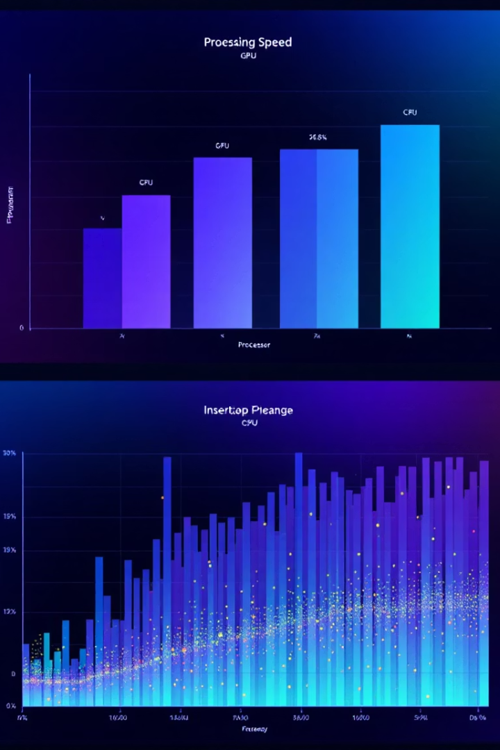
Experimental Results: Performance Gains
GPU Speedup
Up to 8.5x acceleration
CPU Speedup
Up to 5x acceleration
Optimal Conditions
More insertions, small affected region
Recomputation Advantage
When most graph changes

Slide 12
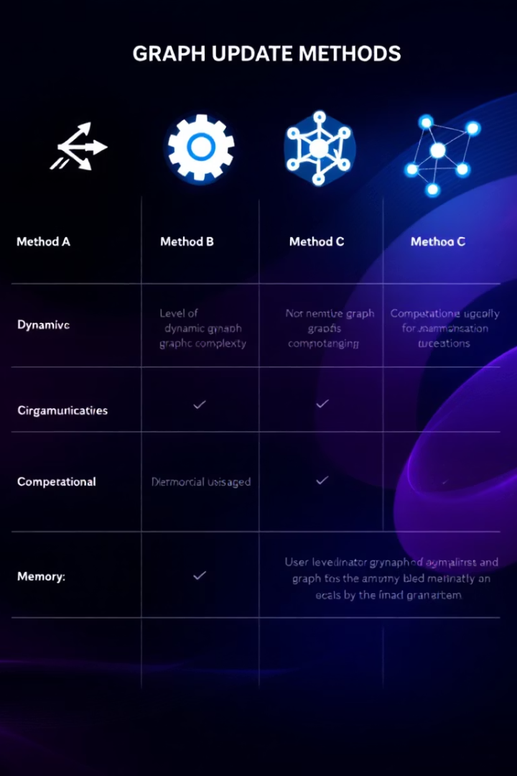
Comparison With Existing Methods
Method
Type
Approach
Weakness
Gunrock
GPU
Recompute all
Inefficient for updates
Galois
CPU
Shared-Memory
Static graphs only
Ours
CPU + GPU
Incremental update
Slight overhead on massive deletions

Slide 13
Visual Results: Speedup Figures
Figure 6
Figure 7
GPU speedup vs Gunrock, up to 8.5x improvement
CPU speedup vs Galois, up to 5x improvement

Slide 14
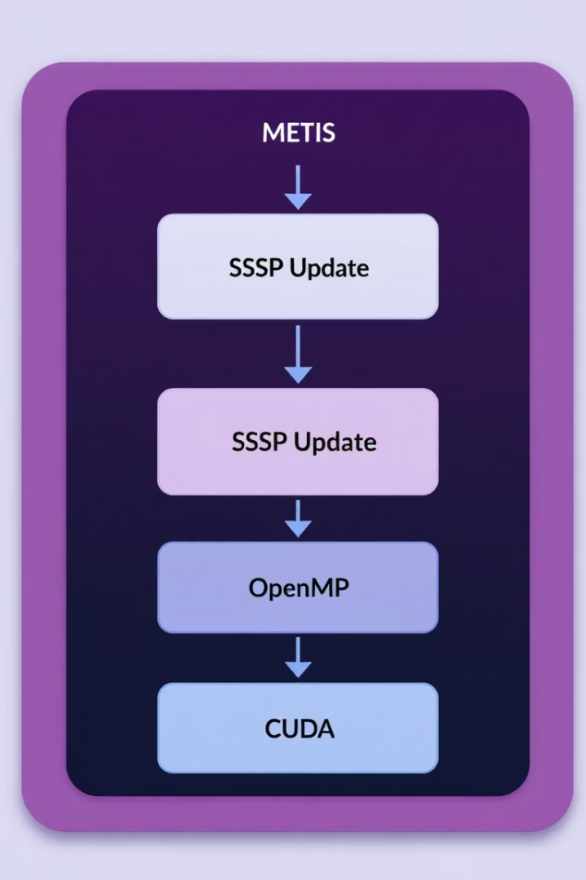
Why This Paper Fits Our Project
Concept Simplicity
Builds on SSSP/Dijkstra methods
Clear CPU-GPU Separation
Facilitates parallel processing
Real-World Relevance
Compatible with METIS, MPI, OpenMP
Ideal for Hybrid Environments
Supports combined CPU/GPU usage

Slide 15
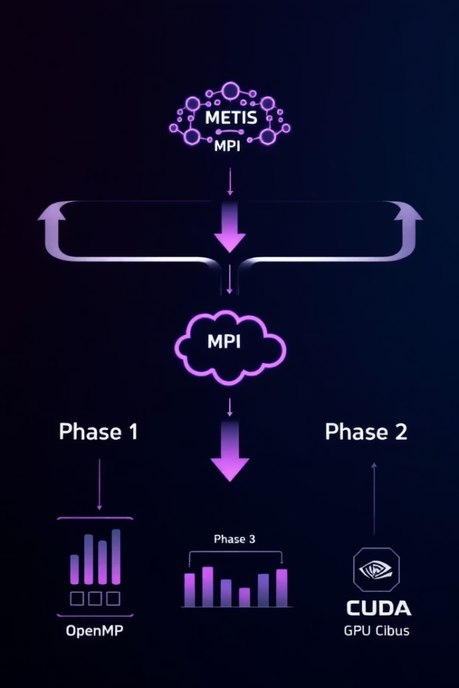
Integration in Our Project Pipeline
Phase 1: Concept
Clear concept, easy presentation
Phase 2: Distribution
Partition graph via METIS, distributed updates with MPI
Phase 3: Intra-node Parallelism
Use OpenMP and CUDA for node-level parallelism

Slide 16
Limitations & Future Directions
Limitations
Future Work
High deletions (>75%) reduce performance
Hybrid recompute or update approach
Load imbalance issues
Predictive batching techniques
Scalability challenged if graph mostly affected
Non-random update scenario testing

Slide 17

Conclusion: Key Takeaways
Efficient Framework
Good Scalability
Platform-neutral update method
Integrates in HPC stacks smoothly
Significant Speedups
Avoids unnecessary recomputation

Slide 18

Q&A: Thank You!
Thanks for listening!
We're happy to take your questions now.

